Slide 1

Why PQC Now for U.S. Federal Missions
25 June 2026
Barbara Saltzman
Program Director, Principal Product Manager
Quantum Safe, Cryptography Management
IBM Software

Slide 2
Bring useful quantum computing to the world Make the world quantum safe
Our (IBM) mission
IBM © 2026 IBM Corporation
2

Slide 3


Our modern digital world depends on cryptography
which is used in trillion of transactions on billions of devices
Internet Protocols
Domain Name Service (DNS), Hyper-text Transfer Protocol (HTTP), Telnet, SFTP
Critical Infrastructure
Code updates; Control systems- Oil pipelines, Electric grids; Car systems,…
Blockchain Applications
Coin wallets, Transactions, Authentication
Digital Signature Laws
Financial Systems
Enterprise Applications
EMAIL – PGP, Identity Management PKI/LDAP/.., Virus scanning patterns, PKI Services
EiDAS - PDF Advanced Electronic Signature – (PAdES), Advanced Electronic Signatures (AES), …
Payment Systems: (EMV, SWIFT, Settlement Systems, FinTech, …)
Systems have long update cycles and data needs to stay secure for a long time
IBM © 2026 IBM Corporation
3
Notes:
1st line: Digital interactions based on TRUST + security 2nd line: Cryptography – ultimate line of defense Safeguarding enterprises through cryptography in PQW = QS
[Click to build] Middle row: Prime factorization, 2048-bit composite integers = 616 digits long, Shor’s algorithm
[Click to build] Bottom: Impacts: public key encryption, digital signatures, key exchange algorithms
I.e.: RSA – DSA – ECC – ECDSA – DH

Slide 4
Cryptography is essential and ubiquitous and embedded across US Federal & Defense Agencies’ Critical Systems and Services
Defense Information Systems Agency (DISA)
DISA uses asymmetric cryptography to secure military communications and safeguard sensitive defense information from unauthorized access. It ensures secure data transmission across military networks and between U.S. allies.
U.S. Department of Homeland Security (DHS)
The DHS relies on asymmetric cryptography for securing communication channels, especially for critical infrastructure protection and cybersecurity operations. It uses encryption to authenticate users and devices in its cyber defense systems.
National Security Agency (NSA)
The NSA employs asymmetric cryptography for securing communications and protecting classified information. It is also involved in the development and evaluation of cryptographic standards used across federal agencies.
Federal Bureau of Investigation (FBI)
The FBI uses asymmetric cryptography to ensure secure communication channels for investigations and intelligence operations. This technology is critical for protecting data integrity and ensuring the confidentiality of sensitive case information.
Internal Revenue Service (IRS)
The IRS uses asymmetric cryptography to secure taxpayers' sensitive information, such as social security numbers and tax returns. It ensures the privacy and security of electronic filings and online taxpayer services.
U.S. Department of State
The Department of State relies on asymmetric cryptography for securing its diplomatic communications and protecting sensitive information shared between embassies and the central office. It ensures the integrity and confidentiality of data transmitted across international boundaries.
Social Security Administration (SSA)
The SSA uses asymmetric cryptography to secure online services, such as applications for benefits and account management. This technology ensures that personal information is protected from unauthorized access and fraud.
Centers for Medicare & Medicaid Services (CMS)
CMS employs asymmetric cryptography to secure sensitive health information and protect the privacy of Medicare and Medicaid beneficiaries. It ensures secure data exchanges between healthcare providers and government databases.
National Aeronautics and Space Admin. (NASA)
NASA uses asymmetric cryptography to protect sensitive data transmitted between Earth and its space missions, including satellite communications and rover data transfers. It safeguards mission-critical information from cyber threats and unauthorized access.
U.S. Postal Service (USPS)
The USPS utilizes asymmetric cryptography to secure its digital services, including online postage and mail tracking systems. It helps prevent fraud and protect the confidentiality of customer data during electronic transactions.
IBM © 2026 IBM Corporation
4
Notes:
Defense, Security, Law Enforcement departments and agencies
Securing communications channels
Protecting sensitive and classified information
Citizen facing services – IRS, USPS, SSA, CMS
Securing citizen digital services
Securing sensitive, PII information, privacy
Securing information exchanges
Diplomatic communications and
sensitive information between embassies and central offices
And NASA, protecting sensitive data communications
between Earth and space missions.

Slide 5
What will a cyber criminal be able to do?
“Q-Day” – availability of “cryptographically relevant” Quantum Computer
…before
…after
Harvest confidential data
Decrypt lost or harvested confidential data
Disrupt business with manipulation
Manipulate digitally signed contracts and legal history
in order to decrypt them later
by breaking encryption
through fraudulent authentication
by forging digital signatures
IBM © 2026 IBM Corporation
5

Slide 6



The problem with Q-Day?
A new threat model
“Q-Day” – availability of “cryptographically relevant” Quantum Computer
…before
…after
Capability Level 1 (moonshot “cryptographically relevant” Quantum Computer)
Capability Level 2
(slow “cryptographically relevant” Quantum Computers at scale)
Capability Level 3
(fast “cryptographically
relevant” Quantum Computers)
…before
No Quantum attacks
but secrets are harvested
Few and expensive quantum attacks
Low-cost quantum attacks
Active quantum attacks
Evolution of capabilities leading to different attack targets
IBM © 2026 IBM Corporation
6

Slide 7
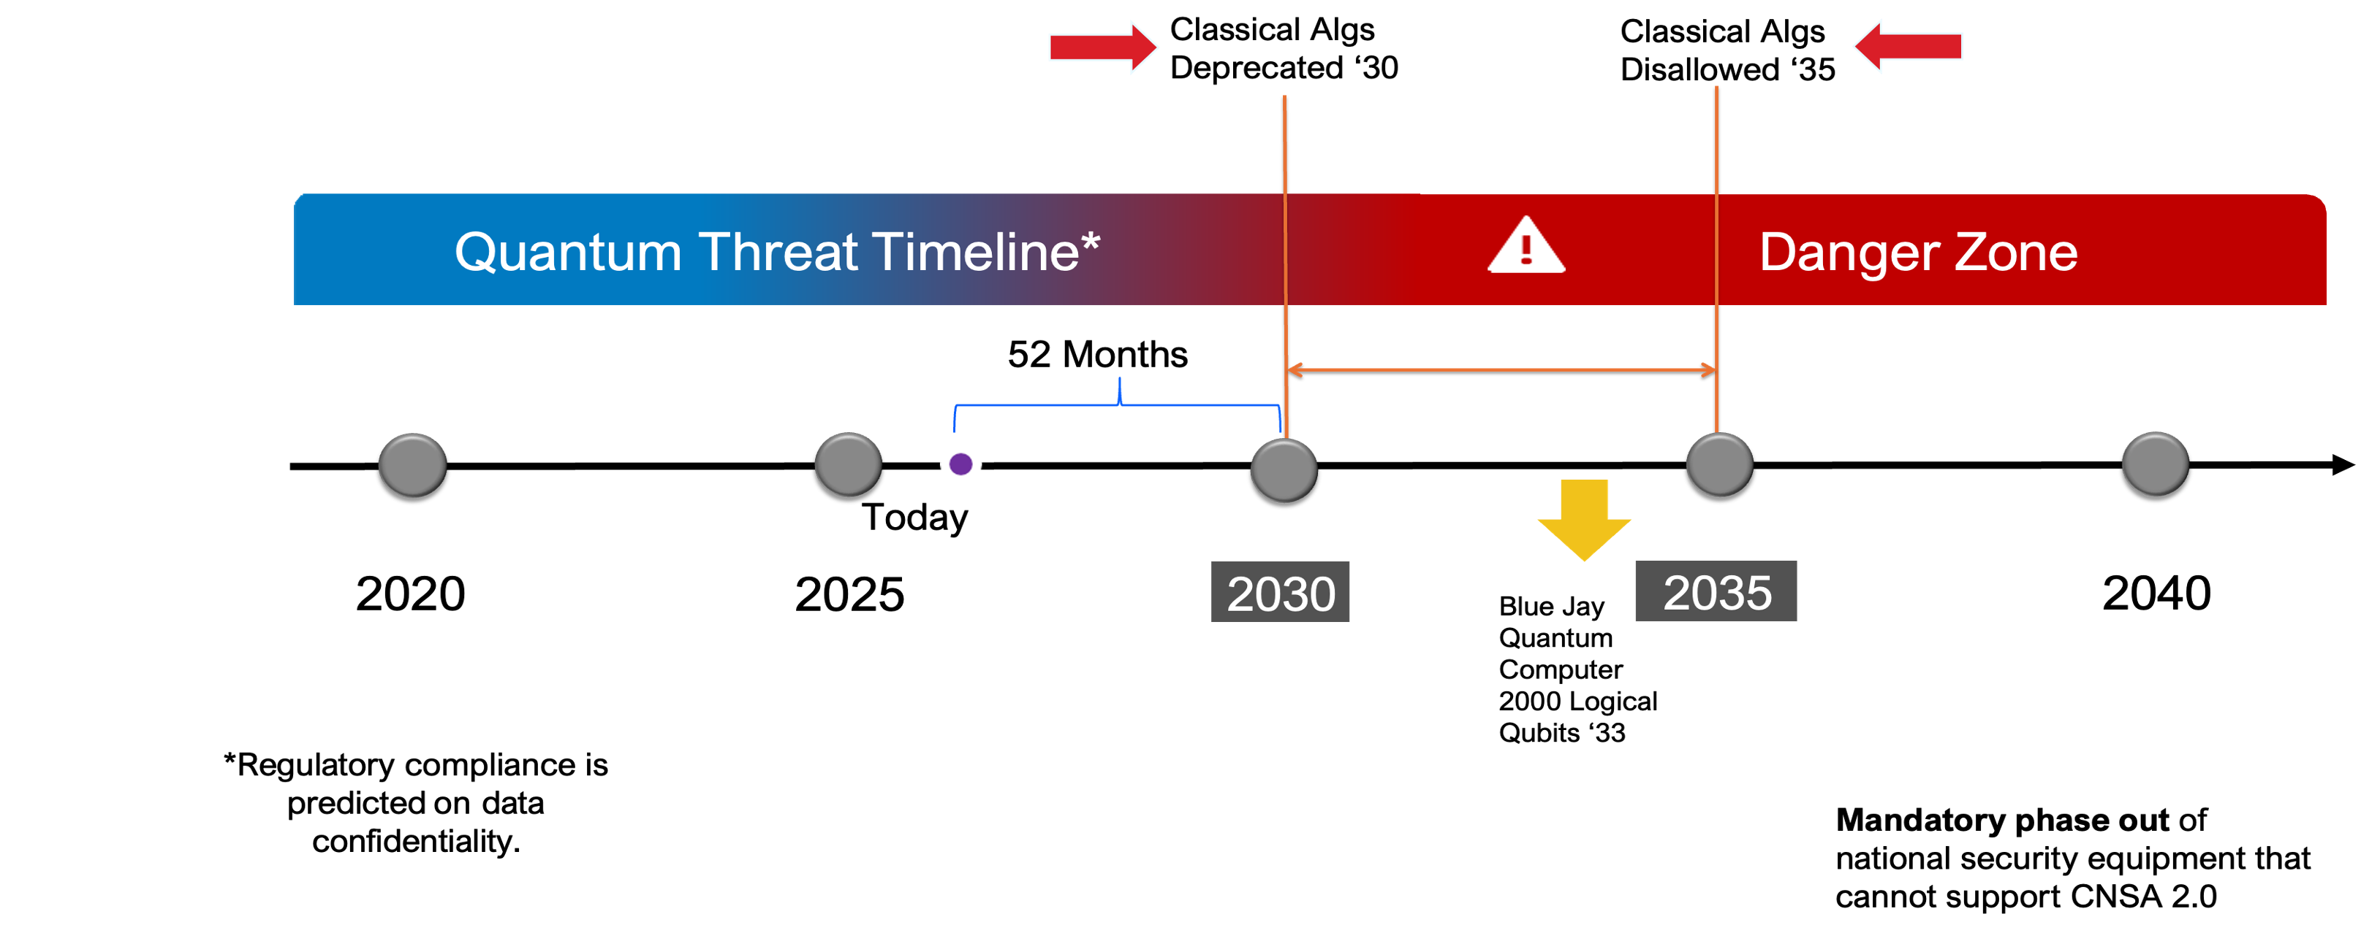
Common question: When will the Quantum threat materialize?
<4 Years
CNSA = Commercial National Security Algorithm, a set of cryptography standards for U.S. National Security Systems
IBM © 2026 IBM Corporation
7

Slide 8
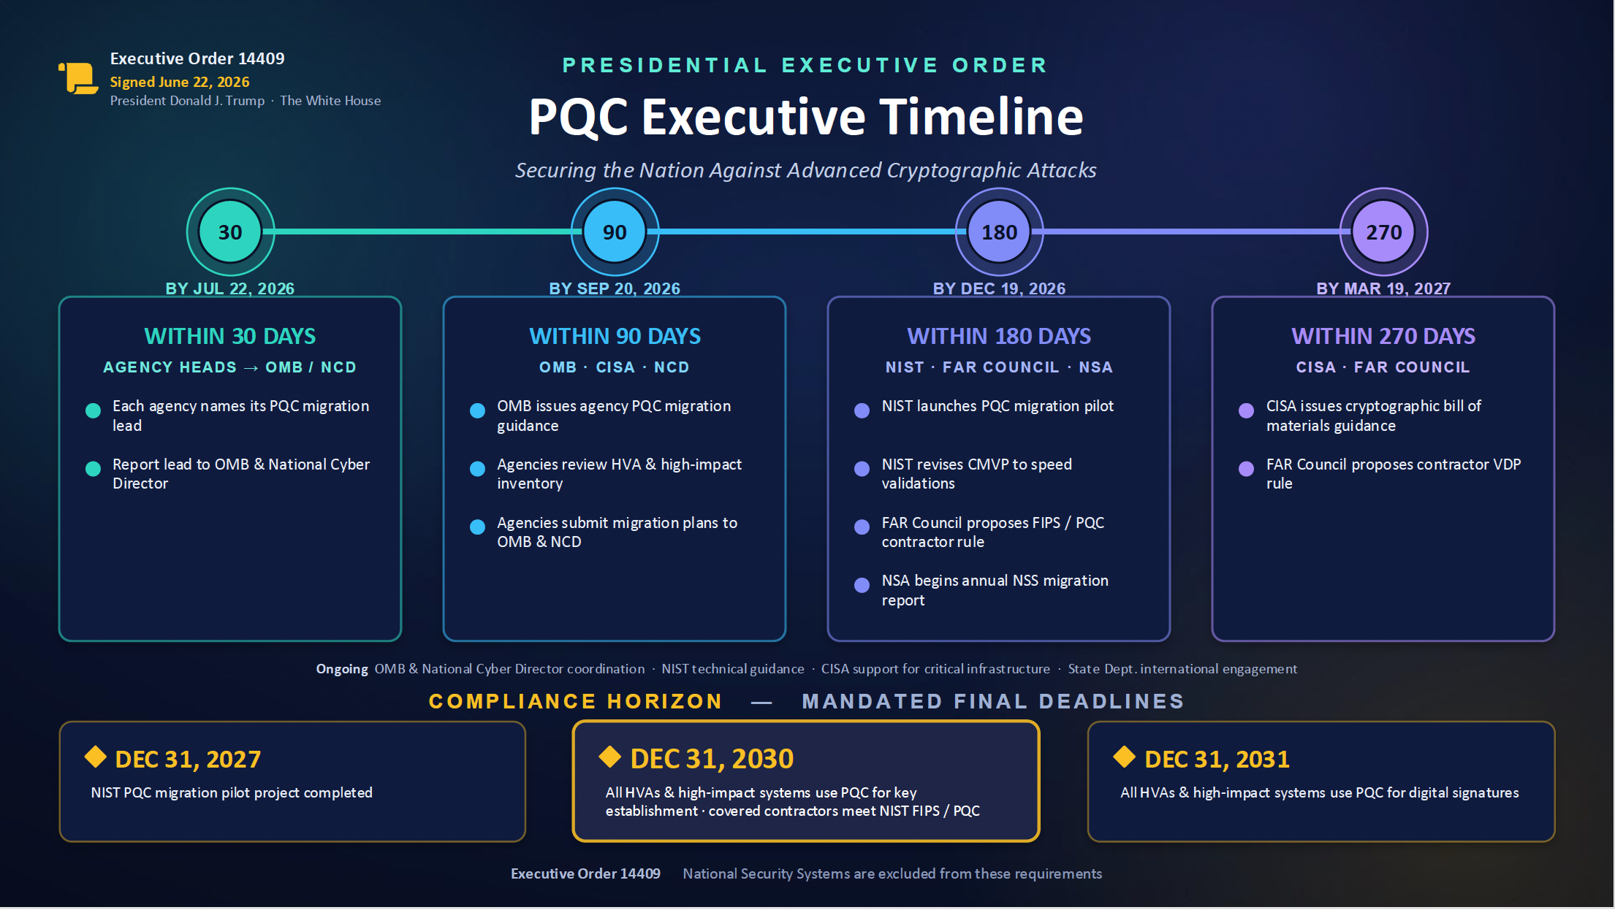
IBM © 2026 IBM Corporation
8

Slide 9
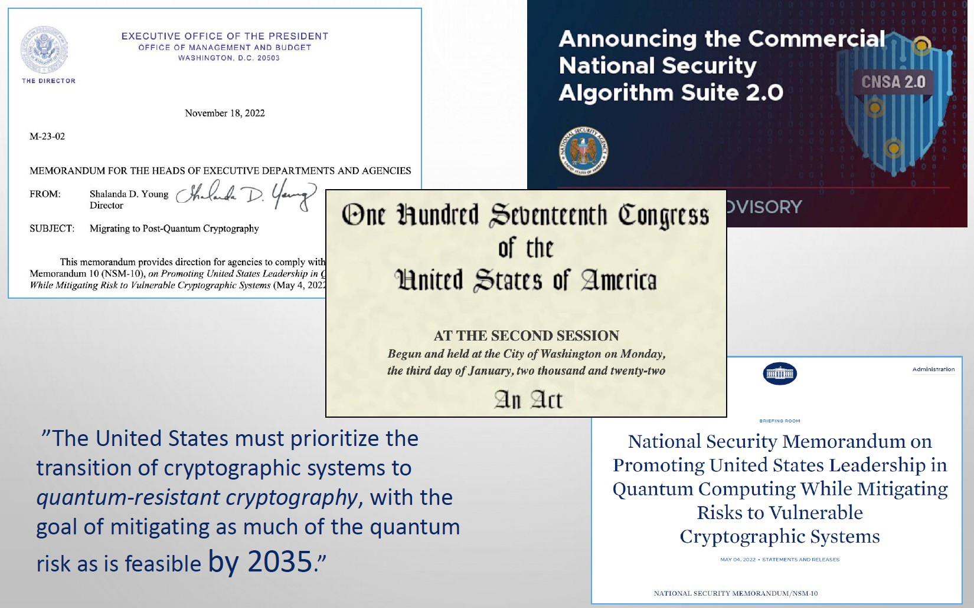
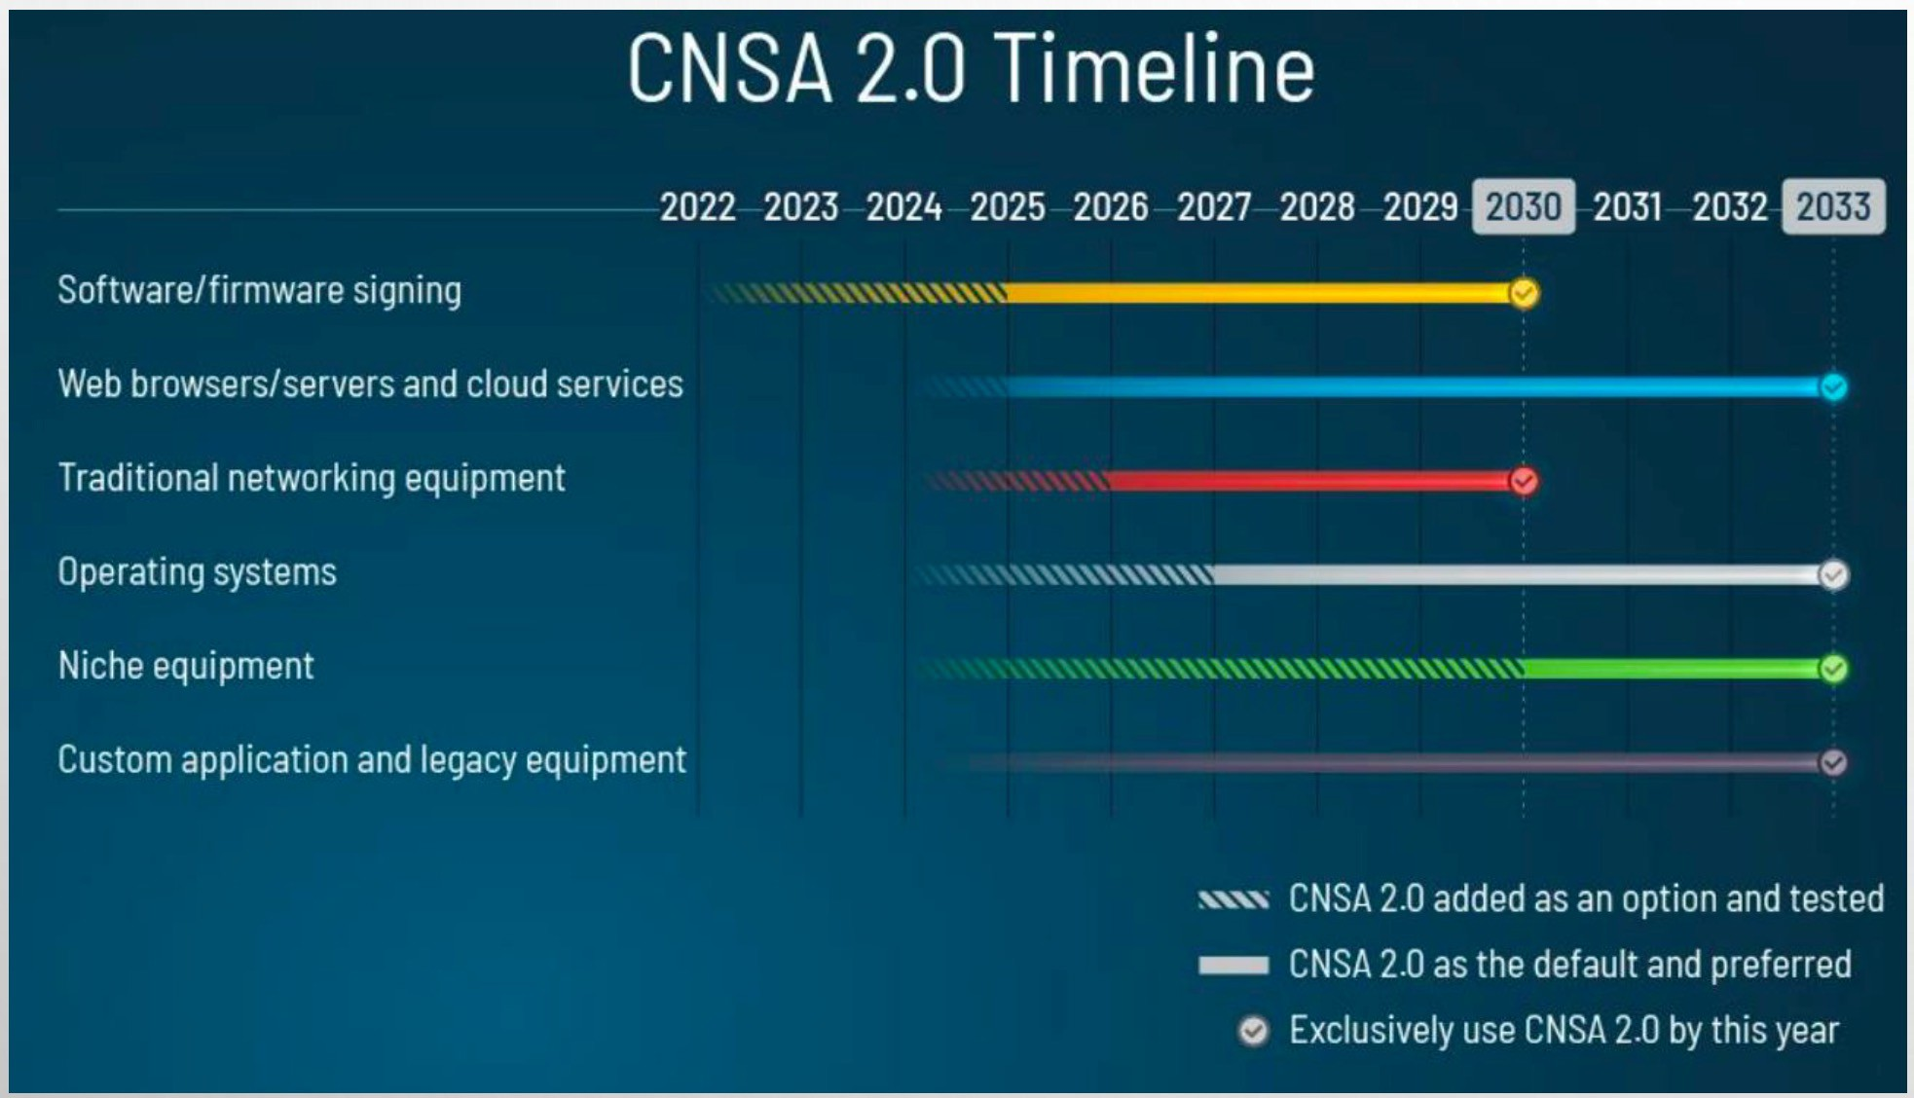
US Government Mandates Quantum Safe for Federal Agencies
CNSA 2.0: Quantum-safe standards are preferred for national security systems by the mid-2020s and required by the early 2030s to defend against threats.
IBM © 2026 IBM Corporation
9

Slide 10
There is global urgency to build quantum resilience across enterprises
NIST, NSA and CISA
All recommend organizations create cryptographic inventories and integrate them into risk assessment processes to prioritize quantum-safe cryptography adoption as soon as possible.³
US National Cyber Strategy & EO
Signed in March 2026, accelerates the modernization and resilience of PQC adoption by directing agencies to have visibility into cryptographic inventory in the next 2 years.
EU Members
Guidance from 18 EU member states requires preparation for quantum threats be integrated into cybersecurity risk management.
Early protection of sensitive data is critical to avoid leaving key assets exposed.²
Singapore Financial Institutions
The Monetary Authority of Singapore issued an advisory to urging financial institutions to prepare for the transition to post-quantum cryptography.⁴
India Telecommunications
India’s Telecommunication Engineering Centre (TEC) published a technical report on migration to post-quantum cryptography.⁵
Indonesia Defense University
The university’s Center for Quantum Security Ecosystem (CQSE) introduced a roadmap for the development of a national quantum security system.⁶
National Security Memorandum 10, Young, 2022
2. Securing Tomorrow, Today: Transitioning to Post-Quantum Cryptography, BSI, 2024
Quantum-Readiness: Migration to Post-Quantum Cryptography, CISA, 2023
Advisory on Addressing the Cybersecurity Risks Associated with Quantum, Monetary Authority of Singapore, 2024
Migration to POST QUANTUM CRYPTOGRAPHY, Telecommunication Engineering Centre, 2025
Indonesia Defense University Launches Center for Quantum Security, Strengthening National Cyber Sovereignty, Intimedia, 2025
IBM © 2026 IBM Corporation
10

Slide 11
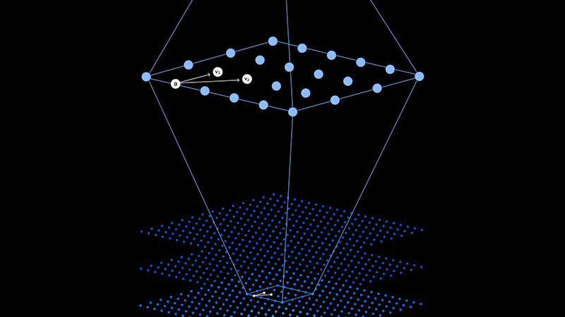
Post-Quantum Cryptography a.k.a. Quantum Safe Cryptography or Quantum Resistant Cryptography
Traditional public-key cryptography relies upon mathematical problems that are difficult to solve on classical computers.
Quantum-safe cryptography includes a suite of algorithms and systems that are resistant to attacks by both classical and quantum computers.
IBM © 2026 IBM Corporation
11

Slide 12
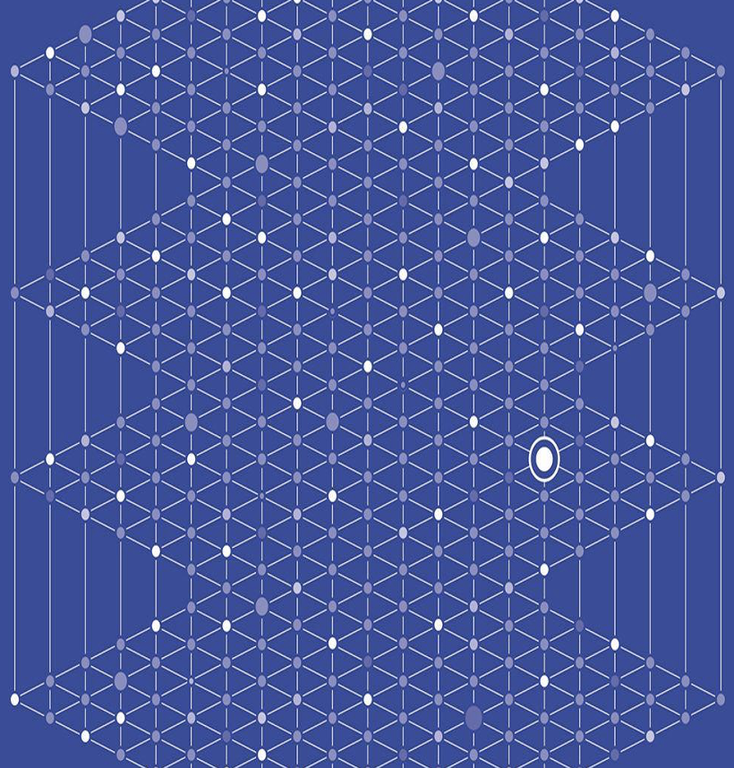
Quantum Safe Cryptography Primarily Lattice-Based
Key differentiations with lattice cryptography
Efficient and fast implementations compared to RSA
Support wide range of applicability for hybrid cloud & edge
Building block for advanced crypto schema (i.e., Fully Homomorphic Encryption, Zero Knowledge Proofs, ID based encryption)
IBM © 2026 IBM Corporation
12
Notes:
IBM web page:
Fully homomorphic encryption (FHE) is an innovative technology that can help you achieve zero trust by unlocking the value of data on untrusted domains without needing to decrypt it.
While encryption provides protection, the sensitive data typically must first be decrypted to access it for computing and business-critical operations. This opens the door to potential compromise of privacy and confidentiality controls. Until now, those vulnerabilities have been the cost of doing business in the cloud and with third parties.
With fully homomorphic encryption, you can better enforce zero trust because the data is always encrypted and can be shared, even on untrusted domains in the cloud, while remaining unreadable by those doing the computation. In short, one can now do high-value analytics and data processing, by internal or external parties, without requiring that data to be exposed.
Google search
Fully Homomorphic Encryption (es the exact result of the same computation performed on raw, unencrypted plaintextFHE) is a powerful form of encryption that allows algorithms to perform computations directly on encrypted data without ever decrypting it. The resulting encrypted output match.

Slide 13
The NIST Post-Quantum Cryptography (PQC) Standard
FIPS 203: Module-Lattice-Based Key-Encapsulation Mechanism (ML-KEM), formerly known as CRYSTALS-KYBER*
Primary algorithm for key encapsulation (key exchange)
Can be used by two parties to establish a shared secret key over a public channel
FIPS 204: Module-Lattice-Based Digital Signature Algorithm (ML-DSA), formerly known as CRYSTALS-DILITHIUM*
Primary algorithm for digital signatures
Can be used to generate and verify digital signatures
FIPS 205: Stateless Hash-Based Digital Signature Algorithm (SLH-DSA), formerly known as SPHINCS⁺
Stateless hash-based algorithm for digital signatures
Can be used to generate and verify digital signatures
IBM-Developed Algorithms Announced as NIST's First Published Post-Quantum Cryptography Standards, IBM Newsroom, 2024
IBM’s quantum-safe signature schemes advance in NIST’s PQC process, IBM Research, 2025
* CRYSTALS-Kyber and CRYSTALS-Dilithium (also) Falcon developed by IBM Research team, in collaboration with industry and academic partners
IBM © 2026 IBM Corporation
13

Slide 14



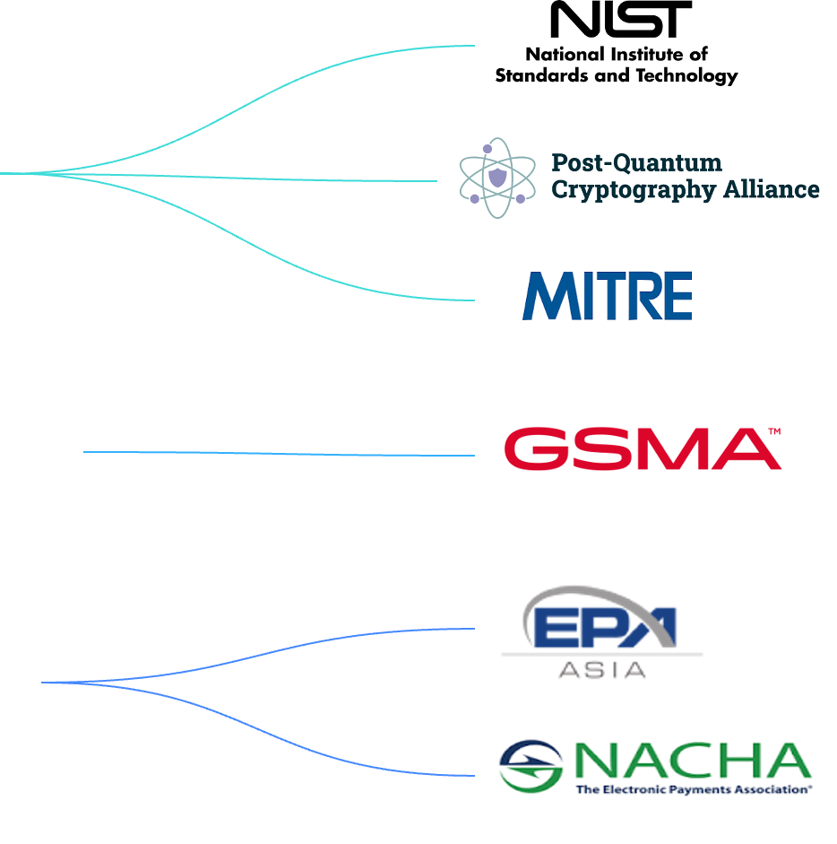
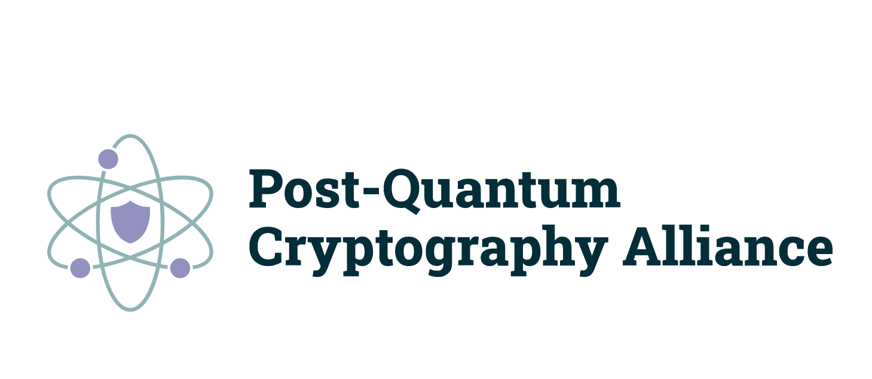
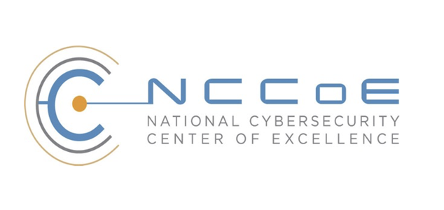
Quantum-Safe Ecosystem global industry, government, and community collaboration for a successful transformation journey
Open-source projects
Linux Foundation (PQCC)
Contributing to the open- source development and prototyping of quantum-safe algorithms and protocols
Centers of excellence
Industry consortia
NIST National Cybersecurity Center of Excellence (NCCoE)
Cross Industry
Providing expertise to drive the next generation of quantum- safe cryptography standards
Telecommunications
Open Quantum Safe (OQS)
Financial Services
IBM © 2026 IBM Corporation
14

Slide 15
Organizations face technology challenges in managing cryptography
Quantum Threats
By 2030, NIST will deprecate the first quantum-vulnerable algorithms¹, and “Harvest Now, Decrypt Later” attacks put data at risk today
Lack of Visibility
Only 45% of organizations say they have full visibility into their cryptographic estate²​
Growing need to understand interfaces and dependencies
Lifecycle Complexity
The lifespan of a TLS certificate is set to be reduced from 398 days to just 47 days
Effective March 2026, maximum lifespans reduced to 200 days
Tool Sprawl
Fragmented tools increase friction, complicating risk management and making compliance harder
Transition to PQC Standards, NIST, 2024
2024 Global PKI, IoT and Post Quantum Cryptography Study, Bob Sullivan, 2024
IBM © 2026 IBM Corporation
15

Slide 16
How to tackle both today’s challenges and build resilience against the quantum threat:
Crypto-Agility
“The ability to rapidly adapt cryptographic mechanisms in response to threats, technological advances, or vulnerabilities – without disrupting infrastructure or business processes”
[krip-toh-uh-jil-i-tee]
noun
Update cryptography when it is broken
Change when regulations / new threats require it
Monitor that its being used properly
Retire cryptography when it is out of date
IBM © 2026 IBM Corporation
16

Slide 17
A technology-driven approach to achieving crypto-agility
Protecting today. Preparing for tomorrow.
Strategize
Discover
Assess
Remediate
Govern
Strategize and plan your quantum safe initiative from a tops-down priority perspective
Discover and inventory your cryptographically related landscape for increased visibility
Assess your cryptographic posture to gain insight and prioritize vulnerabilities
Remediate, protect and mitigate: adopt crypto-agile, orchestrate lifecycle, take action
Govern PQC initiative and cryptographic posture with policy-driven compliance
IBM © 2026 IBM Corporation
17
Notes:
IBM’s approach to achieving crypto-agility is done with the goal of protecting today and preparing for tomorrow.
We aim to help clients on their journey towards crypto-agility by addressing four use cases
Discover and Inventory
Automatically and continuously discover and inventory your cryptographic landscape
Assess and Comply
Assess your cryptographic posture to prioritize vulnerabilities and maintain compliance
Manage Lifecycle
Simplify and automate cryptographic object management
Protect and Adapt
Encrypt data and adopt a crypto-agile architecture

Slide 18
Key questions leaders should answer now
Agency Head / Board / CEO / CRO / CISO
What’s my Quantum exposure?
– “Which identities, data, and AI systems are most exposed?”
CIO / CTO
Where do I start the migration?
– “Which domains and use cases do we tackle first?”
Vendor Management
Are my suppliers Quantum Safe ready?
– “Can our vendors, platforms, and CAs meet PQC timelines?”
Compliance / Legal / Data Protection
How do I stay compliant?
– “How do we align with NIST, NSA, EU, industry guidance?”
IBM © 2026 IBM Corporation
18

Slide 19
What should federal agencies and enterprises should do next? Key steps to build a quantum-resilient future with agility
1
Gaining visibility into cryptography use across organization
Organizations often lack visibility into the interfaces, protocols, algorithms, libraries, keys, certificates, and other cryptographic assets used by their network, data sources, and in-house and 3rd party applications.
2
Prioritizing vulnerabilities by impact
With potentially hundreds of data sources, thousands of applications, and tens of thousands of endpoints that may use vulnerable cryptography, enterprises need to prioritize remediation according to risk to protected data and with constraints in mind.
3
Preparing for the journey to being Quantum Safe
Adapting applications and networks to post-quantum cryptography will be a years-long process. Organizations need tool(s) that provides context for what assets should be prioritized for updates. Focus on resiliency and continuous progress.
4
Complying with ever-changing standards and regulations
Cryptographically-relevant quantum computing will enable an ongoing threat to encryption standards, even with new post-quantum cryptography. Users will need to maintain a secure cryptographic posture in the post-quantum era.
5
Keep bridging the cryptography agility and knowledge gap
Many security teams lack familiarity or expertise with cryptography topics. They need agile solution that helps bridge implementation and governance and knowledge gap through automated and recommended next steps.
IBM © 2026 IBM Corporation
19

Slide 20
IBM’s Leadership in Cryptography IBM Pioneered first data encryption standard, now PQC and CBOM Standards
NBS & US Govt.
NIST & US Govt.
Round 4 Finalists selected - Jul 2022 (3 of the 4 Finalists contributed by IBM)
→ CRYSTALS-Kyber → CRYSTALS-Dilithium → SPHINCS+
→ FALCON
CBOM Standard in CycloneDX 1.6
Non-lattice submissions:
MAYO, UOV, SQIsign, FAEST
Industry’s first data security standard: DES
Formal Call for Proposals
Sept 2016
NIST Standards: ML-KEM FIPS 203, ML-DSA FIPS-204
SLH-DSA FIPS-205
Deadline for Submissions
Nov 2017
Round 2
Round 3
CycloneDX 1.7
1972
2016
2017
2018
2019
2020
2021
2022
2023
2024
2025
2026
IBM’s Lucifer algorithm
Proposal Generation
NSA CNSA 2.0
IBM Guardium Cryptography Manager
IBM Quantum Safe Explorer
IBM Infrastructure
Quantum-safe tape announcement
IBM Cloud
Availability of quantum-safe algorithms and communication
Submission Phase
IBM open source announcement: OQS
IBM z16
First quantum- safe platform
Nov 18 Presidential Executive Order
IBM Quantum Safe Remediator
IBM z17
Expanded quantum- safe security
IBM DataPower Gateway
Quantum safe encryption
Analysis Phase
IBM Guardium Quantum Safe
New signature round (June 2023)
Draft Standards Phase
IBM © 2025 IBM Corporation
20
Notes:
2Q25
IBM z17 expanded the Quantum-safe security, with additional cryptographic algorithms and improved key management, future proofing against quantum threats building on the support for CRYSTALS-Kyber and CRYSTALS-Dilithium algorithms introduced in IBM z16.
Aug 2024 IBM press release
The standards include three post-quantum cryptographic algorithms: two of them, ML-KEM (originally known as CRYSTALS-Kyber) and ML-DSA (originally CRYSTALS-Dilithium) were developed by IBM researchers in collaboration with several industry and academic partners. The third published algorithm, SLH-DSA (initially submitted as SPHINCS+) was co-developed by a researcher who has since joined IBM. Additionally, a fourth IBM-developed algorithm, FN-DSA (originally called FALCON), has been selected for future standardization.

Slide 21
Strategic Approach to Quantum Safe 5 stages to achieve quantum-safe readiness
The journey to quantum safe has multiple entry points and is not linear.
The time to act is now.
Strategize
Discover
Assess
Remediate
Govern
IBM © 2026 IBM Corporation
21

Slide 22
IBM Institute of Business Value studies, re: PQC and Quantum Safe
October 2025, Secure the Post Quantum Future
https://www.ibm.com/thought-leadership/institute-business-value/en-us/report/2025-quantum-safe-readiness
May 2024, The Quantum-Safe Clock is Ticking
https://www.ibm.com/thought-leadership/institute-business-value/en-us/report/quantum-safe
IBM © 2025 IBM Corporation
22

